Slide 1



Data Bootcamp Final Project Presentation
Template
COVID-19 AND IT’s Impact on EDUCATION, SOCIAL LIFE and MENTAL HEALTH OF STUDENTS

Slide 2
Your Name | Project Title
Amanda Roberts
Covid-19 Impact on Students Education, Social Life and Mental Health

Slide 3
About Me
Background
I graduated from University with a BSC (Hons) in Computing where I programmed in Cobol, SQL and C++. I wanted to work in education and use my Computing Degree as a pathway, after having my first child and being more aware of the challenges children faced in the education system and how this impacted them.
I worked in a special needs school as an ICT Teaching Assistant and later worked in primary schools as a Teaching/Learning Support Assistant, providing support for children with various special needs and learning disabilities.
I provided support for young children using a holistic approach and to be a voice for children and their families.
Experience or Qualifications
Data Analytics Bootcamp Digital Marketing Bootcamp NCFE Certificate in Teaching and Learning in Schools HND IN Computing

Slide 4
Why did you choose to learn Data Analytics, and what role would you like to work in following what you've learned?
I worked in education as a Teaching Assistant in Primary Schools providing support for children with special needs and learning disabilities.
I decided to retrain to combine my love of tech and my passion for working with special needs children. I am seeking an opportunity to continue empowering children and their families but from a data analysis perspective so that I can use my analytical skills to help drive government and organisational decisions and push real change to continue to empower marginalised people so that they can fully contribute to society and build a brighter future.

Slide 5
About your project
The Objective of my project was to investigate the Impact that Covid-19 had on Education, Social Life and Mental Health of Students.
I chose this dataset as I understand how change of environment and circumstances can have a dramatic impact on children’s education, social life and mental health. I also worked remotely during lockdown and experienced challenges when teaching children.

Slide 6
How did you apply what you have learnt in the Bootcamp?
Should show how you used project management principles Excel, data SQL , Tableau , Python where necessary
BEST PRACTICE
I made a copy of the original dataset and worked on the copy. This prevents making any mistakes on the original one. Clean the data, looking for duplicates and errors. I had to think about what questions I needed to ask about the data.
Include comments on my SQL code for readability to explain sections of SQL Statements and to be able to clearly understand code that has been written. This is important for anyone who looks at my code who may not have any knowledge of SQL.
I also understand the importance of including comments before coding.
I’m able to interpret the results and explain in non-technical terms using the correct Data Visualisation.
To use the correct colours for your visualisation and titles.

Slide 7
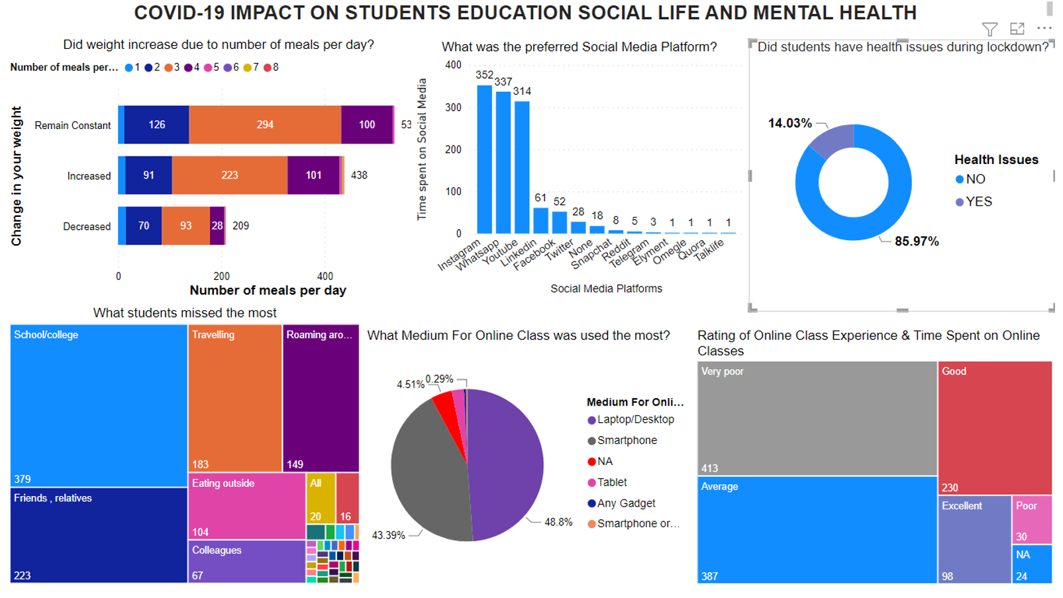
Findings

Slide 8
Top 3 Things you have learnt on the bootcamp
Educationally
I have learnt how to perform functions using Excel such as MIN, MAX, SUM, VLOOKUP, XLOOKUP, PIVOT TABLES, SORTING. Program using MYSQL and some understanding of Python. To use Tableau and Power BI for data visualisation.
Personally
I value the importance of education and embrace opportunities. Prior to enrolling on the Data Analytics Bootcamp I began a Digital Marketing Bootcamp which helped me to meet deadlines, become more resilient than I was before and helped me with perseverance, this enabled me to enrol on the Data Analytics Bootcamp as I was able to see the endless possibilities for a new career. The Data Analytics bootcamp has given me the confidence to challenge myself more, take risks and even when adversity comes to never give up and continue to have a Growth Mindset.
Career Wise
I would like to secure a position as a Data Analyst in Education because this is where my passion is, to help the next generation. I am continuing to find ways to explore more about SQL and Google Analytics Certification

